Slide 1
Post-Hoc Explainability in Natural language
Processing
Notes:
Welcome everyone to the session on post-

Slide 2
PRESENTATION OUTLINE
Motivation and Challenges in NLP
Desirable properties for explainability in NLP
Overview of Post Hoc Explainability methods for NLP
Perturbation based Feature Attribution Methods
Gradients based Feature Attribution Methods
Implementation libraries for post hoc explainability in NLP
Evaluating generating Explanations
Summary
Notes:
* Hello welcome to the explainability in NLP module, - todays objective of the presentaion outline focused on a theoratical overview of some of the post hoc explainability methods in NLP:
* We talk about explainability in NLP and why is it so important and what are the unique challenges that make explainability hard in this domain.
* This will be followed by looking at desirable properties that explainability methods should have. What counts as a good explaination method? What are some of the properties that these explanation methods should satisfy? We will briefly touch on some axioms in game theory that align with these properties.
*We then talk about post hoc explainability in NLP and initially give a high level overview of the methods available- going into detail for some of these methods later.
* After this we dive deeper into details of specific perturbation and gradient based feature attribution methods going into some detail of individual methods.
* We also give a high level overview of some of these libraries available that implement these explainability methods
* We talk about some techniques on how generated explanations can be evaluated.
* Finally we summarise our module.

Slide 3
interpretability in Natural language processing (NLP)
Motivation
Quickly evolving field! (Lots of applications, new architectures, word embeddings, models released!)
Challenges
Gaps between benchmarks and usefulness with real-world data and applications.
Evaluation frameworks and studies lack consistency. Sometimes too simple or unrealistic.
Writing perturbation functions is a complex task and sometimes requires domain expertise.
Intrinsic bias associated with large language models.
Not all NLP tasks are text classification- some gradient based explainability methods are adapted from computer vision.
Diverse variation in the input space.
Balkir, E., Kiritchenko, S., Nejadgholi, I., & Fraser, K. C. (2022). Challenges in Applying Explainability Methods to Improve the Fairness of NLP Models. arXiv preprint arXiv:2206.03945.
https://explainml-tutorial.github.io/neurips20
Notes:
Natural language processing (NLP) is a complex field and it is rapidly evolving with new applications like text generation, machine translation, question answering etc.
New architectures are released for language models like BERT, GPT 3, T5 etc. It is important to understand the complex decisions made by these language models and also identify associated biases. The NLP domain is a unique domain, and there are challenges associated with explainability in this field. Some of these challenges include:
* Although many benchmark datasets and associated explanations in the form of human rationales are released, there effectiveness is limited to real world data applications due to high variation in real world datasets.
* Evaluation frameworks also lack consistency across studies and often errors are pre-determined and very simple, what is considered as a good explanation by humans might not accurately capture the behaviour of the complex black box model. Evaluation frameworks can also vary according to domain and can be affected by quality of training data available in that domain.
* Some post-hoc explainability methods rely on perturbations of the input text. Generating meaningful perturbation distributions can be a very challenging task and can result in unrealistic samples. It may also require domain expertise.
* Large language models also exhibit intrinsic bias- as they are trained on wikipedia and external datasets, they pick up both the good and the bad. There is an intrinsic bias to address here, which is composed of model biases and semantic biases associated with large language models. Model bias are biases that are due to model structure, and are responsible for the over-amplification of discrepancies that are observed in training data. Semantic bias refers to biases introduced from the pre-trained representations, and include representational harms such as stereotypical associations. It is important to realise that this bias is hard to fully mitigate and must be evaluated in a post-hoc manner when using these large language models.
* In addition to the above, not all tasks are text classification, some gradient based explainability methods leverage gradients of the model with respect to input and these methods are adapted from computer vision.
* The domain in NLP can have discrete, structured, combinatorial inputs- so diverse variation.

Slide 4
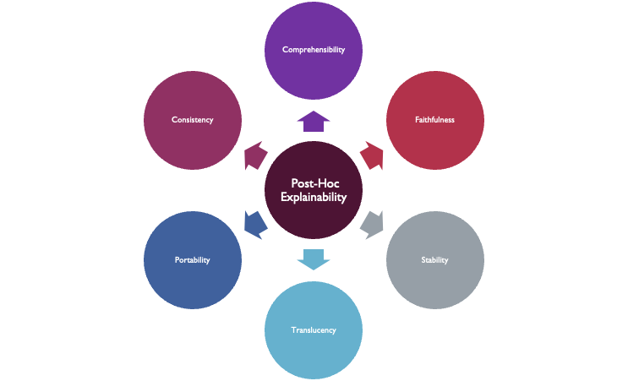
Desirable properties of Post-Hoc Explainability methods
Some common axioms in game theory are:
Sensitivity/Dummy
Symmetry/ Substitutability Efficiency/ Completeness
Additivity/Linearity
Belle, V., & Papantonis, I. (2021). Principles and practice of explainable machine learning. Frontiers in big Data, 39.
Molnar, C. (2020). Interpretable machine learning. Lulu. com
Notes:
Before we dwelve into the indivdual explainability methods, it is important to understand some key terms that are used to describe explainability methods. These terms signify the properties that a desirable/good post hoc explanation should have.
PostHoc explanability methods and generated explanations should have some of the following desirable properties:
Comprehensibility/Plausibility: This implies the extent to which extracted representations are humanly comprehensible and easy to understand.
Fidelity/Faithfulness: This implies the extent to which extracted representations accurately capture the opaque/black box models from which they were extracted. Are the explanations accurately capturing the behaviour of the complex blacbox model?
Stability: How much the explanation method is strongly affected by slight changes of the feature values of the instance to be explained?
Translucency: This implies How much the explanation method relies on looking into the machine learning model, like its parameters. Depending on the scenario, different levels of translucency might be desirable. The advantage of high translucency is that the explanation method can rely on more information to generate explanations. The advantage of low translucency is that the explanation method is more portable.
Portability: Portability describes the range of machine learning models with which the explanation method can be used. Methods with a low translucency have a higher portability because they treat the machine learning model as a black box.
Consistency: How consistent are the explanations generated by the post-hoc method? How much does an explanation differ between models that have been trained on the same task and that produce similar predictions?
A good explanation method should try to satisfy these properties.
Before we look into explanability methods, it is important to know that there are some fundamental axioms in game theory that many of post-hoc explainability methods use.
These axioms give these methods solid mathematical foundations and also provide explainability methods desirable properties we have talked about earlier.
Please review these axioms in more detail in your own free time.

Slide 5
Post Hoc Explainability for Text Classification
Post-Hoc Explainability : Explainability after a model has been trained.
Broad Categories:
Perturbation based (Model agnostic)
Gradient based (Model specific)
Notes:
Text classification involves categorising text into different categories. It has a lot of applications in the real world scenario. for example, classifying emails into spam and not spam, classfying documents based on their content into different categories, sentiment analysis tasks etc.
Explainability methods that are post-hoc in nature attempt to reveal the reasons behind a model’s prediction after a model has been trained. Explainability can be both at a local and global level.
There are two broad categories in which we can classify the posthoc explainability methods for text classification for this module.
These methods include:
* Gradient based methods leverage gradients of differentiable models (neural networks) to generate explanations. This makes them model specific. Provided with an already trained diffrentiable model, they compute saliency scores for the words/tokens of an input text instance. In NLP, Saliency scores show how each word/token in text - attributes positively or negatively to the predictions the black box model makes for that text input instance. Attribution is calculated by looking at the embedding layers inside the model. As tokens get entered into this layer- they gain a continuous representation of meaning, gradient based methods look into this layer while computing attributions.
* Perturbation based methods create a perturbation distribution around individual text instances and these pertubations are used to create explanations by investigating the behaviour of the complex black box model to the perturbed samples. These methods are model agnostic. These methods give weight to pertubed samples based on their similarity to the original text and either fit a simple model with intrepretable features/words from the perturbation distribution to explain the behaviour of the complex black model or identify words that anchor the predictions locally such that presence of those words would almost always result in the same model prediction. Some of these methods also try to perturb the text to identify how similar data points would lie on opposite sides of the decision boundary.

Slide 6
Post Hoc Explainability Methods for
Text Classification
Interpretability Type | Approach | Category | Example Methods
Post-Hoc | Model Specific | Gradient based (Differentiable models) | Saliency maps (Simonyan et al. 2015) Gradient*input. (Shrikumar et al. 2016) Layer-wise relevance propagation (LRP) (Bach et al. 2015) Influence functions (Han, Wallace and Tsvetkov, 2020) Deep Learning Important FeaTures (DeepLift) (Shrikumar et al. 2017) Integrated Gradients (IG) (Sundararajan et al. 2017) Deep SHAP (Lundberg et al., 2017)
 | Model Agnostic | Perturbation based | Shapely values (Shapley, Lloyd S., 1953) Local Interpretatable Model-agnostic Explanations (LIME) (Ribeiro et al. 2016) Anchors: High Precision Model Agnostic Applications (Ribeiro et al. 2018) Kernel SHAP (SHapley Additive exPlanation) (Lundberg et al., 2017) Partition SHAP (Lundberg et al., 2017) POLYJUICE (Counterfactuals) (Wu et al., 2021)
Notes:
The following are some of the methods of post hoc explainability. As we discussed earlier that gradient based methods are model specific and leverage gradients of differentiable models by utilising the embedding layer for a NLP model. Gradients have the advantage of being locally ‘faithful’ by construction: they tell us how much the loss/gradients would change, were we to perturb a token by a small amount. These methods are also faster compared to perturbation based methods.
Some methods in this category include:
* Saliency maps (vanilla) which are gradients of loss function with respect to inputs. The gradient of the loss is computed with respect to each token in the input text, and the magnitude of the gradient serves as a feature importance score.
* Gradient * Input (Shrikumar et al., 2016) was at first proposed as a technique to improve the sharpness of the attribution maps. The attribution is computed taking the gradients with respect to the input and multiplying them with the input itself.
* LRP computes feature relevance at each neuron inside a neural network iteratively by propagating prediction backwards using a series of different local propagation rules. These propagation rules apply in the context of relu activation. Intutively a neuron is relevant is it has high activation and it contributes to a lot of neurons in the higher layer. In this weighted fashion, attributions are calculated for the input.
* Influence functions that seek clues inside the model parameters to locate influential instances for the model to make predictions. In contrast to explanations in the form of token level heatmaps (saliency heat maps), the influence function provides a method for tracing model predictions back to training examples. They can be used to understand and debug the model behaviour.
* Integrated Gradients and Deep Lift which are improvements to LRP but include the concept of a baseline/reference. Gradient based attribution is calculated from a baseline/reference input.
* Deep SHAP: Deep SHAP is a high-speed approximation algorithm for SHAP values in deep learning models that builds on a connection with DeepLIFT. SHAP values are approximate shapely values- which we will talk about next.
Perburbation based methods rely on perturbation distributions of the input test instance to explain behaviour of black box model. Some model agnostic methods in this category include:
* Shapely value: This is a model agnostic explainability method takes its roots from cooperative game theory and has solid mathematical properties that give it reasonable justifications to explain a models behaviour. The shapely value is the marginal contribution of a feature for all of the records in a dataset. The interpretation of the Shapley value is: Given the current set of feature values, the contribution of a feature value to the difference between the actual prediction and the mean/average prediction is the estimated Shapley value. Solid framework and groundings in cooperative theory.
* LIME: LIME tries to fit a simple model (usually a linear model) on a complex black box model using intrepretrable features derived from the pertubation distribution on an instance of interest. This is a model agnostic method focused on local explainability.
* Anchors: This generates explanations based on a set of rules. Perturbed samples are created for an instance of interest. Anchors/words are identified in an optimisation task such that given the anchor/word in the instance of interest and the pertubration distribution - will almost always result in the same prediction. This is a model agnostic method focused on local explainability.
* Kernel SHAP: combines LIME with the SHAP values notion and changes the parameters of LIME to retrieve them.
* Parition SHAP: Recursively tries a hierarchy of features to determine shap values.
* PLYJUICE- a general purpose counterfactual generator trained by fine-tuning GPT-2 (a transformer based model) on multiple datasets of paired sentences. (Wu et al., 2021). This method is the opposite of anchors and focuses on understanding why similar data points are on the opposite side of the decision boundary.

Slide 7
Perturbation based Attribution Methods
Local​ Explainability | Global​ Explainability
Shapely​ | Shapely​
LIME​ | SP-Lime​ (Collection of local explanations)
Anchors​ | SP-Anchor (Collection of local explanations)​
SHAP | SHAP
Notes:
* First we will visit some of the perturbation based methods for post-hoc explanations. Explainability can be global or local.
* Local explanations explain individual predictions and help to determine if individual predictions are made for the right reasons.
* Global explanations aims to explain the complete behaviour of a given blackbox model. They help to look at the big picture to explain the overall behaviour of model for different classes/sub-groups. In a NLP standpoint, these could be words/tokens that are most influential to explain positive/negative reviews in a sentiment analysis task etc.
* In this module, we will cover some of these methods mentioned here.

Slide 8
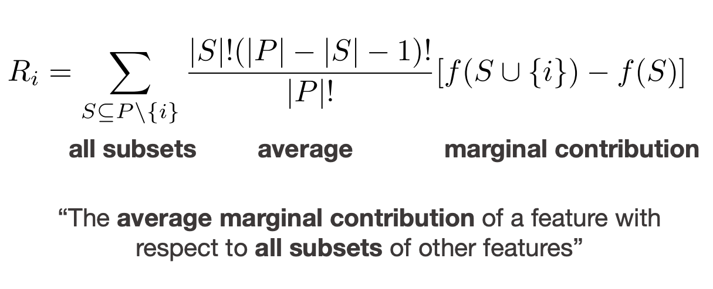
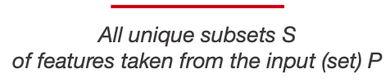
Shapely value
Marco Ancona , icml 2019
Shapley, Lloyd S., 1953
Read more here: https://towardsdatascience.com/the-shapley-value-for-ml-models-f1100bff78d1
Notes:
* The shapely value takes its groundings from cooperative game theory.
* The Shapley value is calculated by computing a weighted average of the marginal contribution that a feature i provides when included in all subsets that exclude that feature i.
* Marginal contribution here captures the incremental contribution of a feature to the model’s output while accounting for its interaction with other features.
* It is important to remember that the shapely values can be misinterpreted. For a ML model, it’s not possible to just “exclude” a feature for determining predictions.
* Within a ML context, “excluded” features mean, sampling the empirical distribution of that feature’s values and averaging over multiple samples.
* Computing all possible subsets and the empirical distribution of the feature values and averaging over multiple samples can be computationally expensive depending on the sampling strategy, which is why most real-world methods approximate shapely values.
for reference:
An empirical distribution is one for which each possible event is assigned a probability derived from experimental observation. It is assumed that the events are independent and the sum of the probabilities is 1. An empirical distribution may represent either a continuous or a discrete

Slide 9
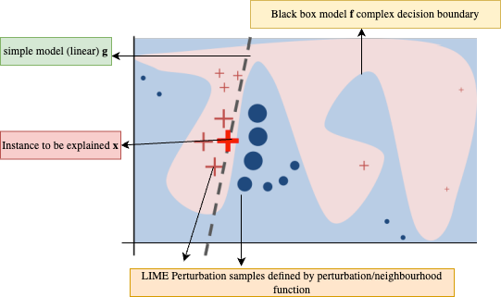
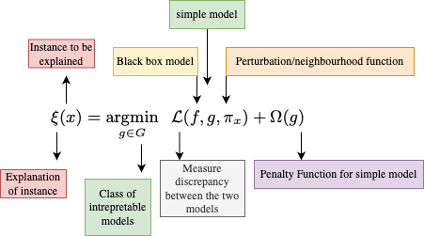
Local Intrepretable Model agnostic Explanations (LIME)
Explanations generated are an Optimisation Problem: Fit a simple model locally with intrepretable features on a complex blackbox model in a local neighborhood defined by the neighbourhood/pertubation distribution function.
Ribeiro, Marco Tulio, Sameer Singh, and Carlos Guestrin. "" Why should i trust you?" Explaining the predictions of any classifier." Proceedings of the 22nd ACM SIGKDD international conference on knowledge discovery and data mining. 2016.
Notes:
Explanations generated are an Optimisation Problem: Fit a simple model locally with intrepretable features on a complex blackbox model in a local neighborhood defined by the neighbourhood/pertubation distribution function.
Toy example to present intuition for LIME. The black-box model’s complex decision function f (unknown to LIME) is represented by the blue/pink background, which cannot be approximated well by a linear model. The bold red cross is the instance being explained. LIME samples instances, gets predictions using the black box model, and weighs them by the proximity to the instance being explained (represented here by size). The dashed line is the learned explanation that is locally (but not globally) faithful.
* For text, data, words or group of words are frequently used as interpretable variables.
* New data instances are sampled by using perturbations of the instance of interest. For text, new instances are created by randomly removing words from original text. The dataset is represented with binary features for each word. A feature is 1 is corresponding word is included and 0 if removed.
* Explainability method takes perturbed data points with labels and gets inference from black box model, distances as weights (points closer to original have greater impact) and optionally maximum number of features to use in explanation to generate local explanations for instances of interest.
* Selecting number of features is a hard problem. The number must strike a balance between the complexity of the model and the simplicity of the explanation.
* Mathematically the explanation can be thought of as optimisation problem that seeks to minimise a loss function between predictions of the complex black box model and the simple model in the presence of a perturbation distribution defined by the neighburhood/pertubtation function function. The complexity of the simple model can be adjusted by some hyperparameters.
* Lime is often used as a reference when evaluating other explainability methods due to the simplicity of its implementation.

Slide 10
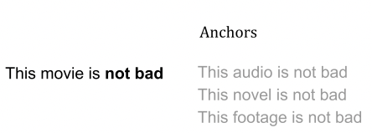
Anchors: High-Precision Model-Agnostic Explanations
Model agnostic explanations based on IF-THEN rules.
“An anchor explanation is a rule that sufficiently anchors the prediction locally – such that changes to the rest of the feature values of the instance do not matter. In other words, for instances on which the anchor holds, prediction is (almost) always the same"
Given a text instance x, a blackbox model f ,an anchor A and a pertuburation distribution D:
A (x) = 1 & A is a sufficient condition for f(x) with high probability.
Sufficient condition: If the anchor is present in the instance, changes to feature predicates via the perturbation distribution should not matter and target class predictions are accurate.
Ribeiro, Marco Tulio, Sameer Singh, and Carlos Guestrin. "Anchors: High-precision model-agnostic explanations." Proceedings of the AAAI conference on artificial intelligence. Vol. 32. No. 1. 2018.
Notes:
Anchors are model agnostic explanations based on IF-THEN rules.
“An anchor explanation is a rule that sufficiently anchors the prediction locally – such that changes to the rest of the feature values of the instance do not matter. In other words, for instances on which the anchor holds, prediction is (almost) always the same"
Given a text instance x, a blackbox model f ,an anchor A and a pertuburation distribution D:
Your anchor for the instance x is one (A (x) = 1) which means the anchor is a sufficient condition for the model f(x) to classify/predict the instance of interest (x) with high probability
Sufficient condition implies that for the instance of interest If the anchor is present in the instance, changes to feature predicates via the perturbation distribution should not matter and target class predictions are accurate
In this example, for the text instance "the movie is not bad", the explanation method identifies an anchor "not bad" - which is a sufficient condition for the model to classify sentences with these words as a positive review.
You would also note that The model also classifies the samples in perturbation distribution correctly if this anchor is present, whereas the feature predicates may have changed like the "This audio is", "this novel is", "this footage is" etc.
You define these accuracy/confidence thresholds inside the algorithm.

Slide 11

Anchors: High-Precision Model-Agnostic Explanations
Search for anchors is defined as a combinatorial optimization problem to maximize Anchor coverage using the beam search algorithm:
D = perturbation distribution around an instance x
Cov(A) = probability anchor A applies to samples from D- gives coverage of the anchor.
⏉ = desired level of precision (confidence threshold)
Prec (A) = anchor precision.
δ = Size of the beam width.
Ribeiro, Marco Tulio, Sameer Singh, and Carlos Guestrin. "Anchors: High-precision model-agnostic explanations." Proceedings of the AAAI conference on artificial intelligence. Vol. 32. No. 1. 2018.
Notes:
The Search for anchors is defined as a combinatorial optimization problem to maximize Anchor coverage using the beam search algorithm:
D = perturbation distribution around an instance x
Cov(A) = probability anchor A applies to samples from the perturbation distribution D- This gives coverage of the anchor – which is the region where the explanation applies.
⏉ = desired level of precision (confidence threshold)
Prec (A) = anchor precision.
δ = Size of the beam width. the size of the beam width. A bigger beam width can lead to a better overall anchor at the expense of more computation time.
The anchors are constructed bottom-up in combination with beam search.
Start with an empty rule or anchor, and incrementally add an if-then rule in each iteration until the minimal confidence constraint is satisfied.
If multiple valid anchors are found, the one with the largest coverage is returned.
In order to select the best candidate anchors for the beam width efficiently during each iteration, the problem was formulated as a pure exploration multi-armed bandit problem where each anchor is an arm in the multi-arm bandit problem.

Slide 12

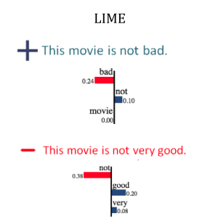
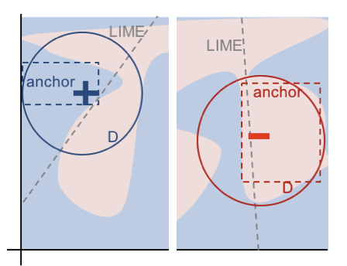
ANCHORS VS LIME
Two toy visualization
Intuitive
Easy to comprehend
Clear coverage (region where explanation applies)
High precision if they apply
Ribeiro, Marco Tulio, Sameer Singh, and Carlos Guestrin. "Anchors: High-precision model-agnostic explanations." Proceedings of the AAAI conference on artificial intelligence. Vol. 32. No. 1. 2018.
Notes:
Compared to LIME, if we look at the two toy visualisation, we can see that the Anchor method is looking into the perturbation distribution (D) around the instances of interest and carving out the biggest possible area where the prediction is positive and negative. This makes anchors intiutive, easy to comprehend, and be able to provide sufficent coverage. They also have high percision if they apply.
Although both explanations are computed to be locally accurate, if we look at the explanations generated by LIME and look at the explanation on the top where sentence is classified as positive and tried to apply it to the explanation on the bottom where the sentence is classified as negative, one might be tempted to think that the word “not” would have a positive influence, which it does not. While such explanations provide insight into the model, their coverage is not clear, e.g. when does “not” have a positive influence on sentiment? Anchors aim to resolve this.

Slide 13
SHapley Additive exPlanations (SHAP)
SHapley Additive exPlanations (SHAP) is a unified framework of methods, or explainers, that approximate Shapley values while adhering to its mathematical properties, for the most part.
SHAP Values are approximate shapley values.
SHAP explains the deviation of a prediction from the expected/baseline value which is usually estimated using a background dataset (often the training dataset).
Allows both local and global model explanations that are CONSISTENT.
Common perturbation-based model agnostic methods for text include:
Kernel SHAP: combines LIME with the SHAP values
Partition SHAP: Recursively tries a hierarchy of features to determine SHAP values.
Lundberg, S., Allen, P. and Lee, S.-I. (2017). A Unified Approach to Interpreting Model Predictions.
Notes:
SHapley Additive exPlanations (SHAP) is a unified framework of methods, or explainers, that approximate Shapley values while adhering to most of its mathematical foundations and properties.
SHAP Values are approximate shapley values that relax some constraints in shapely value computation while sticking to most of its properties.
SHAP Includes the concept of a background/reference dataset (often the training set) to calculate approximate baseline/expected shapely values and explains deviation of prediction from this baseline value.
The baseline/expected value is prediction neutral value that would be predicted if we did not know any features to the class being predicted.
Choice of background dataset matters! Depending on the specific domain and use case, it may be more meaningful to compute the baseline/expected value using a specific subset of the training set as opposed to the entire training set.
For large datasets, computationally expensive to use the entire dataset and we have to rely on approximations (e.g., subsample the data). This can have implications for the accuracy of the explanation.
One of the advantages of SHAP is that it allows both local and global model explanations that are CONSISTENT.
Common perturbation-based model agnostic methods implemented in SHAP for nlp include:
Kernel SHAP: combines LIME with the SHAP values. Kernel SHAP follows the same steps as LIME, such as fitted weighted linear models, but it uses Shapley sample subsets and uses a different Kernel, which returns SHAP values as the coefficients. Some of the drawbacks of this method are it ignores feature dependence and that violates the dummy axiom property when we have collinear features
Partition SHAP: Recursively tries a hierarchy of features to determine SHAP values. Partition SHAP uses Owen values – which extend shapely values to rebalance the problem of correlated features if the partitioning is defined accordingly and are computationally more efficient and tractable to compute

Slide 14
Gradient based Attribution Methods
Local​ Explainability | Global​ Explainability
Influence Functions | Collection of Local Explanations
Layer wise relevance propagation (LRP)
Deep Learning Important FeaTures (DeepLift)
Integrated Gradients (IG)
DEEP SHAP Gradient Explainer SHAP | DEEP SHAP Gradient Explainer SHAP.
Notes:
Now we will look at gradient based feature attribution methods for NLP. Most of these methods produce a saliency map which shows how each input token is important with respect to perturbing the models gradients w.r.t the input. We will start by talking about influence functions, moving on to the intution of LRP, DeepLIFT, IG based algorithms and corresponding implementions in SHAP.

Slide 15
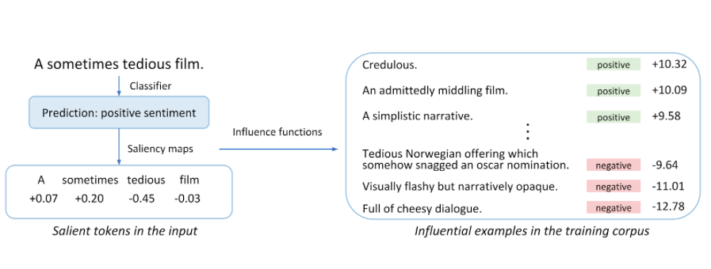
Influence functions
Concept: Deletion diagnostics
Use model parameters and training examples to generate explanations.
Positive influence score:
Removing this example from the training set would drop the models confidence in this prediction.
Negative influence score:
Removing this example from training set would increase the model’s confidence in this prediction.
Han, Xiaochuang, Byron C. Wallace, and Yulia Tsvetkov. "Explaining black box predictions and unveiling data artifacts through influence functions." arXiv preprint arXiv:2005.06676(2020).
Notes:
Rely on the concept of deletion diagnostics: remove certain examples of training data to see model behaviour.
Influence functions seek clues in the model parameters , eventually locating interpretations within the training examples that influenced these estimates.
Influence functions are model specific as they require access to the loss function with respect to the model parameters, which only works for a subset of machine learning models.
Logistic regression, neural networks and support vector machines qualify, tree-based methods like random forests do not.
Influence functions are a useful diagnostic tool to assess and debug model behaviour.
Intuitively:
positive influence score for a training example means: were we to remove this example from the train set, we would expect a drop in the model’s confidence when making the prediction on the test input.
Negative influence score means that removing the training example would increase the model’s confidence in this prediction.
In this example for the input text sentence a sometimes tedious film, the classifier predicts a positive sentiment, while traditional saliency maps would reveal the importance of indivdual tokens, influence functions will look into the model parameters and identify training examples which led to the model predicting positive for this input test sentence. Instances like credulous, an admittedly middling film, a simplistic narrative from the training set influened the model positively to predict this sentence as positive whereas sentences like visually flashy but narratively opaque contributed negatively to the prediction of this sentence as postive.

Slide 16
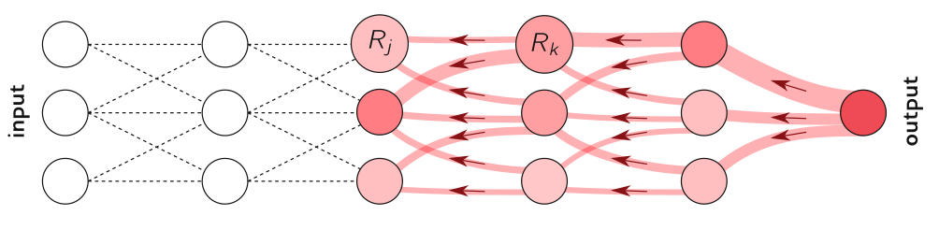
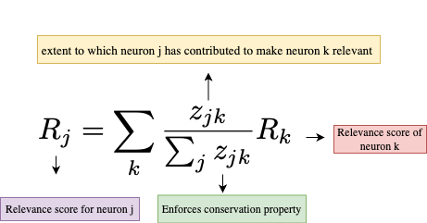
LAYER WISE RELEVANCE PROPAGATION (LRP)
Concept: Compute input feature relevance scores iteratively and propagate.
Prediction is propagated backwards using different local propagation rules.
Conservative property- whatever is received by a neuron must be redistributed to the lower layer in equal amount.
Relevance scores assigned to each neuron are via set of rules in context of RELU activation according to layers of neural net.
Uses principles related with Taylors decomposition. LRP as a succession of Taylor expansions performed at each neuron.
Each neuron redistributes to the lower layer as much as it has received from the higher layer.
Guiding equation to propagate neuron relevance scores
Montavon, G., Binder, A., Lapuschkin, S., Samek, W., & Müller, K. R. (2019). Layer-wise relevance propagation: an overview. Explainable AI: interpreting, explaining and visualizing deep learning, 193-209.
Notes:
This is a gradient based attribution method which has the concept of Computing input feature relevance scores iteratively and propagating these in a weighted fashion.
The prediction is propagated backwards using different local propagation rules. LRP enforces a Conservative property which means that whatever is received by a neuron must be redistributed to the lower layers in equal amount.
LRP assigns a Relevance score to each neuron. This is a via set of rules in the context of RELU activation according to layers of neural net.
LRP Uses principles related with Taylors decomposition. You can think of LRP as a succession of Taylor expansions performed at each neuron.
If we look at this diagram of the neural network and let j and k be neurons at two consecutive layers of the neural network. Given a neuron with Revelance Rk, which receives information from neurons it is connected to in its next layer, it redistributes the information to the neurons it is connected to in the previous layer in a weighted fashion. The Re-distribution is via a set of rules given in the equation below. This is a guiding equation to propagate neuron relevance scores. The Numerator quantifies contribution neuron Rj has in order to make neuron Rk relevant. The Denominator quantifies contribution of all neurons to which Neuron Rk enforces the conservation property. In this weighted fashion, attributions are calculated for the input instance.
Intuitively, a neuron is relevant if 1) it has a high activation, and 2) it contributes a lot to relevant neurons of the higher layer.

Slide 17
Integrated gradients (IG)
Assign an attribution score to each input feature by approximating the integral of the gradients of the model’s output with respect to the inputs.
Mathematical proof: Fundamental Theorem of Calculus for Line Integrals.
Two fundamental axioms in game theory— Sensitivity and Implementation Invariance that attribution methods should satisfy.
Attribution is calculated as compared to a baseline/reference input.
For a NLP model:
The input features are text converted to tokens.
Attributions are calculated from the embedding layer by approximating the integral of the model gradients with respect to the embedding layer along a straight path from baseline to the input instance.
Attributions come out as floating-point numbers for each token.
Sundararajan, M., Taly, A., & Yan, Q. (2017, July). Axiomatic attribution for deep networks. In International conference on machine learning (pp. 3319-3328). PMLR.
Notes:
Integrated gradients assign an attribution score to each input feature by approximating the integral of gradients of the models output with respect to input.
IG take their roots from the fundamental theorem of calculas for line integrals. This mathematical proof ensures that attributions add up.
Calculating the exact integral of the gradients is intractable, so instead, they are approximated this integral using a Reimann sum: the gradients are taken at a lot of small steps between the baseline and the models output w.r.t input.
Authors of this paper argue that Attribution methods should satisfy two important properties, sensitivity and Implementation Invariance. The sensitivity axiom means that variables that don’t change the model output should have zero attribution.
Two networks are functionally equivalent when their outputs are equal for all inputs despite having very different implementations. Authors argue that If an attribution method fails to satisfy Implementation Invariance, the attributions are potentially sensitive to unimportant aspects of the models. Methods like LRP and DeepLIFT fail to satsify this property.
IG calculate feature attribution by comparison to a baseline/reference input
Baseline is the prediction-neutral input to your model, and is model-specific. It describes your model. For a nlp model this is usually a zero embedding vector matching the input sequence length.
It is worth noting that although IG satsifies sensitvity and implemenation invariance, integrated gradients can still assign different attributions to two features that always have the exact same effect on the model (violation of symmetry), and can assign positive attributions to features that have no effect on the model (violation of null effects). The detail proof of these is available in the link in mandatory reading and I encourage you to investigate this.
For an NLP model:
The input features are text converted to tokens.
As tokens are entered into the network via an embedding layer, they gain a continuous representation of meaning. This layer is used to compute meaningful attributions.
The attributions are calculated considering the integral of the model gradients with respect to the word embedding layer along a straight path from a baseline instance x′ to the input instance.
Attributions come out as normalized floating point numbers — one value for each token.

Slide 18
DeepLIFT (Deep Learning Important FeaTures)
Aimed at reducing computational overhead in IG and to solve some failure modes in other gradient based approaches.
Solves cases where discontinuous nature of gradients can cause sudden jumps in the importance scores over infinitesimal changes in the input.
Allows cases where a neuron can be signalling meaningful information even in the regime where its gradient is zero.
DeepLIFT proceeds in the same fashion as LRP but includes the baseline concept of Integrated Gradients.
Instead of redistributing backward the output of the prediction function, it redistributes the difference of it with a baseline. Therefore, it has been designed to satisfy the Completeness Axiom.
Main difference with IG is how attribution is calculated.
DeepLIFT feature attribution scores can be computed efficiently in a single backward pass.
Shrikumar, A., Greenside, P., & Kundaje, A. (2017, July). Learning important features through propagating activation differences. In International conference on machine learning (pp. 3145-3153). PMLR.
Notes:
Aimed at reducing computational overhead in IG and to solve some failure modes in other gradient based approaches.
Solves cases where discontinuous nature of gradients can cause sudden jumps in the importance scores over infinitesimal changes in the input.
Allows cases where a neuron can be signalling meaningful information even in the regime where its gradient is zero.
DeepLIFT proceeds in the same fashion as LRP but includes the baseline concept of Integrated Gradients.
Instead of redistributing backward the output of the prediction function, it redistributes the difference of it with a baseline. Therefore, it has been designed to satisfy the Completeness Axiom.
Main difference with IG is how attribution is calculated.
DeepLIFT feature attribution scores can be computed efficiently in a single backward pass.

Slide 19
Gradient based methods in SHAP
Deep SHAP: High-speed approximation algorithm for SHAP values in deep learning models that builds in connection with DeepLIFT.
Gradient Explainer: Based on connections between SHAP and the Integrated Gradients algorithm.
Detailed Implementation differences on how gradients are computed between Deep LIFT and Deep SHAP can be found here: https://github.com/kundajelab/deeplift#what-are-the-similarities-and-differences-between-the-deeplift-like-implementations-in-deepexplain-from-ancona-et-al-iclr-2018-and-deepshapdeepexplainer-from-the-shap-repository
Important to note that SHAP allows both global and local explainability that are CONSISTENT, unlike other methods.
Lundberg, S., Allen, P. and Lee, S.-I. (2017). A Unified Approach to Interpreting Model Predictions.
https://github.com/slundberg/shap
Notes:
SHAP implements two explainers for gradient based explainability methods.
Deep SHAP is a High-speed approximation algorithm for SHAP values in deep learning models that builds in connection with DeepLIFT.
Gradient Explainer is based on connections between SHAP and the Integrated Gradients algorithm.
Detailed Implementation differences on how gradients are computed between Deep LIFT and Deep SHAP can be found here: https://github.com/kundajelab/deeplift#what-are-the-similarities-and-differences-between-the-deeplift-like-implementations-in-deepexplain-from-ancona-et-al-iclr-2018-and-deepshapdeepexplainer-from-the-shap-repository
Important to note that SHAP allows both global and local explainability that are CONSISTENT.

Slide 20
Summary
Intrepretability/Explainability is important for any ML framework.
Interepretability/Explainability in NLP has unique challenges.
Explainablity methods should have certain desirable properties when generating explanations.
Most post-hoc explainability methods use fundamentals axiom from game theory to satisfy these desirable properties.
Two broad categories for post-hoc feature attribution methods in NLP:
Gradient based (Model specific – suited to neural networks)
Perturbation based (Model agnostic)
Generated explanations can be evaluated for their "goodness" through different methods. (cover in next lesson)
Choice of explainability method is dependent on use case and domain.

Slide 21
Any Questions?

